Slide 1

CSG1132: Assignment 1b
Writing Literature Reviews
Julia Wexler
FHES Learning Adviser
j.wexler@ecu.edu.au

Slide 2
Overview
What is a literature review?
Writing process
Structure
Examples, activity, discussion
This is a discussion not a lecture—please ask questions/make comments as they occur to you!

Slide 3
Recap...
So far, you have:
gotten to know your topic
become somewhat familiar with the literature available and relevant themes through your concept mapping (assignment 1a)
begun to define your specific research questions and provisional thesis statements
Now what?.... You need to write a literature review.

Slide 4
What is a literature review?
A review of current literature on a particular topic or issue.
A comparison of different sources.
An identification of ‘gaps’ in current research.
A critical evaluation and synthesis of the literature, NOT an annotated bibliography.
Your essay will join an on-going conversation about motivation in using social media, so you need to know what others have discovered/are currently exploring.

Slide 5
What is a literature review?
Your literature review should:
place your study in a historical perspective;
evaluate promising research methods;
define and limit the problem you are working on;
identify the ‘gap’ your research will fill.
...It also justifies why your essay should be written!
(Davies, 2011, p. 217)

Slide 6
Reading & researching tips
Read and consider titles & abstracts first
Use “key terms” and “subjects” functions
Use discipline-specific databases to narrow your scope
Don’t get lured in to informal/un-academic web sources
Skim for what you need (don’t read carefully until later)
Note headings in articles (What type of info is covered?)
Systematically map your research journey out
Questions about reading for lit reviews?

Slide 7
Research sources
A good literature review contains a thoughtful balance of source types (peer-reviewed journal articles, reports, internet resources, scholarly books, statistics, etc.).
Remember the 4 Rs:
Recent – When was it published?
Reliable – Who wrote it? Do they use evidence? Is it biased? Who published it?
Readable – Can you understand it? Who is the target audience, scholars or the general public?
Relevant – Useful for your topic area?

Slide 8
Writing process
Define key sources
Look for scholarship that:
covers your general topic area
has attempted to grapple with the various elements of your research question
is of landmark importance in your topic area
justifies your own research study

Slide 9
Writing process
Critical review – for each article
Write down main ideas, themes, and conclusions.
Analyse these main elements and formulate criticisms, questions or doubts.
How is this source relevant to your topic, and others texts you’ve found?
Draft a brief summary of steps a, b, and c. Ensure you include the main idea of the study, evidence presented, your own criticisms, and a statement about the study’s relevance for your research.

Slide 10
Writing process
Compare and contrast
Identify similarities/differences in authors’ viewpoints.
Criticise and compare aspects of methodology.
Highlight outstanding and/or landmark studies.
Identify gaps in research (areas that need to be examined further).
* Use colour-coding or another system to group sources together, and track themes as they emerge. Consider expanding a version of your concept map.

Slide 11
Writing process
Plan and draft
What is crucial for your readers to know in order to set up your own study and the questions you want to answer?
Start broad by outlining the general research area, then gradually narrow in on your specific topic area and questions.
Work towards identifying the ‘gap’ where your own study is positioned, and the justification for it.

Slide 12
Structure
Your Lit Review
Idea 1a
Idea 4+
Idea 4a
Idea 4b
Idea 2
Idea 1c
Idea 1b
Idea 3a
Idea 3b
Ideas read
during research are incorporated into your review, which explains how they relate to each other and your thesis statement

Slide 13
Structure
Introduction: introduces the reader to your topic area, its significance, the purpose of the literature review and how it will be structured. Include a roadmap of how you have decided to present your research (will it be grouped by theme, in order of publication date, categorised by disciplines?).

Slide 14
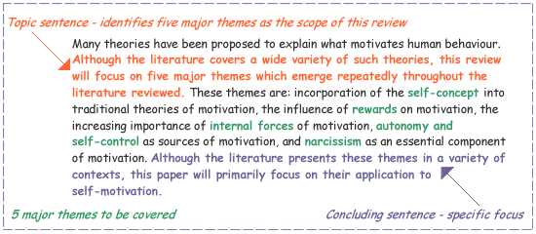
Intro example
(Study and Learning Centre, RMIT, 2005)

Slide 15
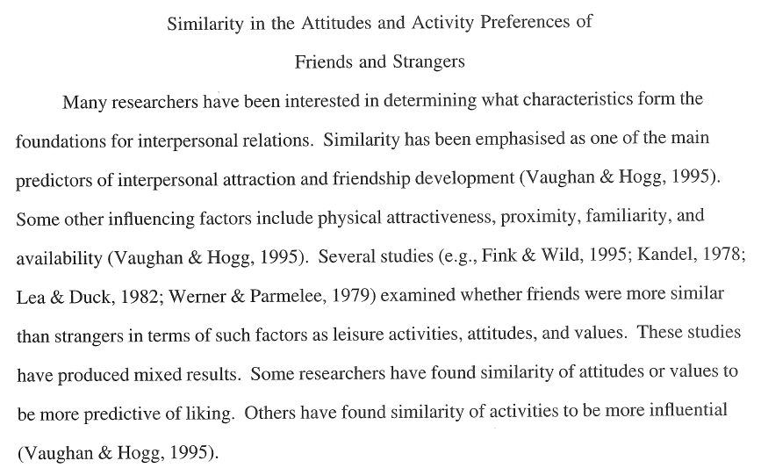
Intro example
(Burton, 2010)

Slide 16
Structure
Body: divided into sub-sections. Each section will contain your critical reviews synthesised together into separate paragraphs, each with their own topic sentence, body, and concluding/transition sentence. Select relevant parts of your critical review summaries and weave them together into your literature review “story.”
Conclusion: restates the purpose of the literature review and briefly summarises the position of the main research aim in relation to current scholarship.

Slide 17
Vocabulary to indicate structure
While Rios (2012) argues ... , Soha (2013) claims that...
Recent studies by Rios (2012) and Soha (2013) both show the effect of ... However, data collected by Hutchison (2014) demonstrates a trend in ...
Early attempts to understand user motivation ... Many psychological studies contributed to ... for example, Janes and Maak (1996). Hunt’s theory of … (1997) explained the role of ... but later Jamison (1999) showed that ... In more recent years/since the advent of …, research has uncovered the importance of …

Slide 18
Explore examples provided
Identify the topic of each paragraph & observe how sources have been woven together w/in each paragraph.
Underline structural vocabulary specific to lit reviews.
Examine how the choice of sources has been guided by the themes identified.
Try to find the transitions—indicate them with a *.
Note the different scope of each example—which one type of organisational structure might you use as a model for your own lit review?
If there’s time, begin drafting your own intro, using themes identified in your concept mapping assignment.

Slide 19
Marking key

Slide 20
References & further reading
Australian National University. (2012). Is your information scholarly? Retrieved from the Australian National University Website: http://libguides.anu.edu.au/content.php?pid=268316&sid=2226891
Davies, M. (2011). Study skills for international postgraduates. London, UK: Palgrave Macmillan.
Gillett, A. (2012). “Features of academic writing.” Retrieved from the Using English for Academic Purposes: A Guide for Students in Higher Education Website: http://www.uefap.com/writing/feature/intro.htm
Lawrence, T. (2012). Literature review. Perth, Australia: Edith Cowan University FHES Academic Skills Centre.
MacDonald, B. & Seel, J. (n.d.). “Research using the internet.” Retrieved from the University of Toronto Website: http://www.writing.utoronto.ca/advice/reading-and-researching/research-using-internet

Slide 21
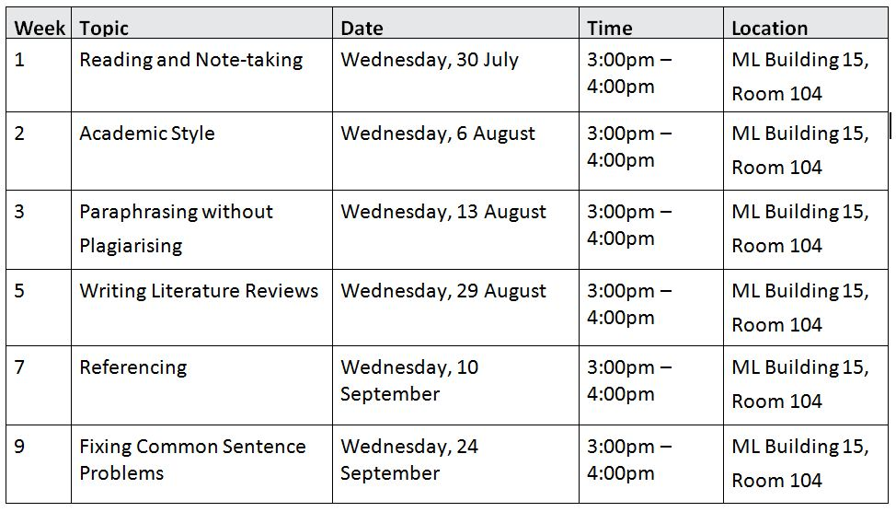
Academic writing workshops @ ML
Online materials available on the FHES Academic Skills Centre community site on Blackboard (link at www.ecu.edu.au/fheslearning

Slide 22
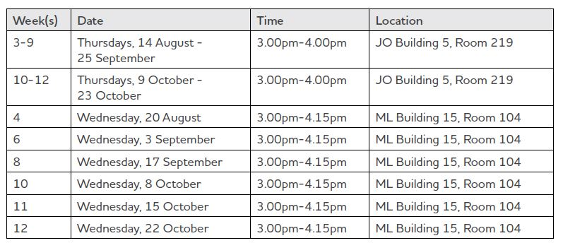
Assignment Drop-In Labs
Or receive electronic feedback over email
SCSS LA (referencing, structure, style): Julia Wexler j.wexler@ecu.edu.au
English language LA: Alejandra Speziali a.speziali@ecu.edu.au

